Slide 1
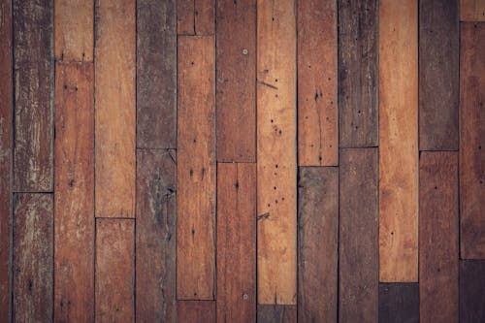
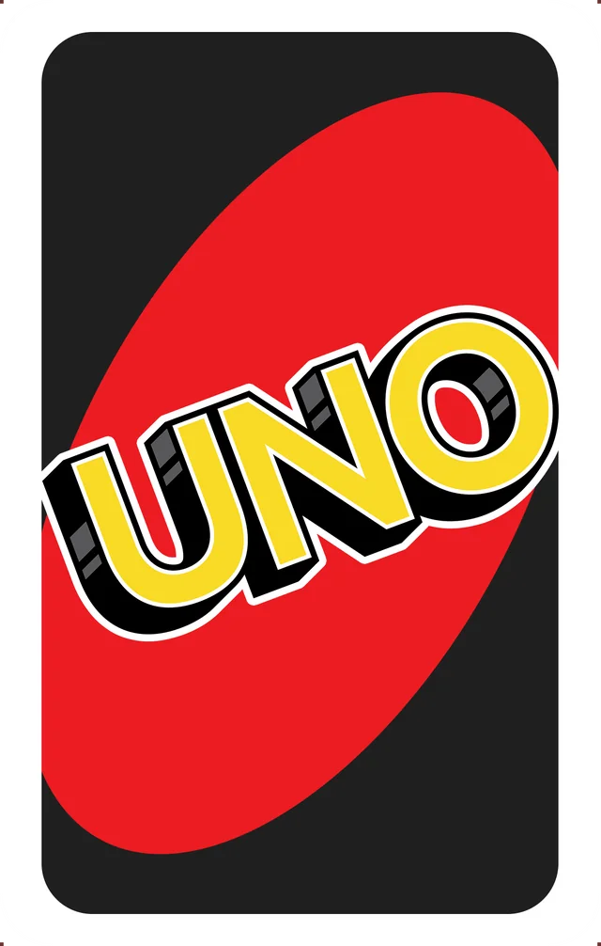
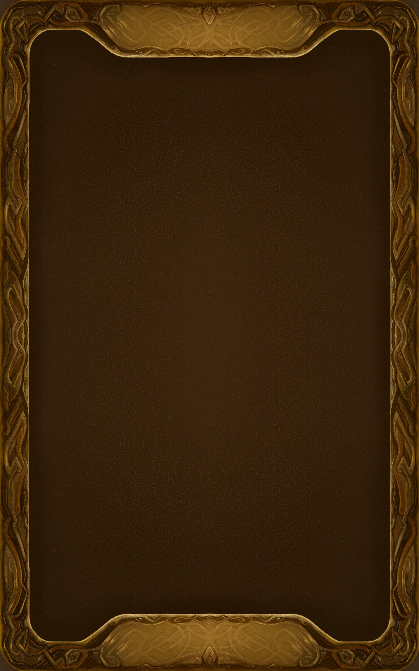
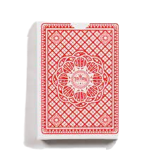
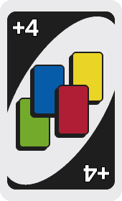

Slide 2
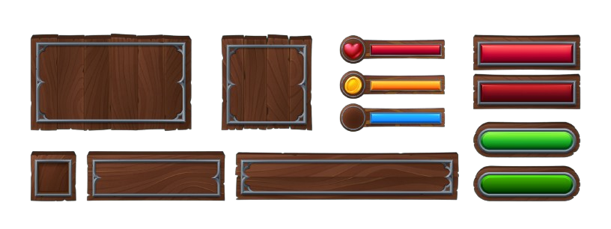

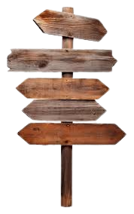

Slide 4
CURRENT COLOR: BLUE

Slide 5
INFO/RULES
1. Match the color or face value of the card present
2. If you have no matching cards, draw a card
3. If your opponent places a black card, your turn is skipped
4. If you have only one card, you must press the UNO button by the end of your turn. If you fail to do so, draw 2 cards
5. Draw 2 cards if you press UNO when you have more than one card
6. The first person (or AI) to have an empty hand wins
May the best player win!

Slide 6
INFO/RULES
May the best player win!

Slide 7
CURRENT COLOR: BLUE
FOUL!
CURRENT COLOR: RED
CURRENT COLOR: YELLOW
DO NOT PRESS UNO WHEN YOU HAVE MORE THAN ONE CARD!
CURRENT COLOR: GREEN
YOU MUST PRESS UNO WHEN YOU HAVE ONE CARD
EFFECT!: DRAW 4
EFFECT!: DRAW 2
EFFECT!: SKIP
EFFECT!: REVERSE

